Slide 1
CSE 304
Design & Analysis of Algorithms
Greedy Algorithms (Part 2)

Slide 2
Job scheduling algorithm
is applied to schedule the jobs on a single processor to maximize the profits.
The greedy approach of the job scheduling algorithm states that,
“Given ‘n’ number of jobs with a starting time and ending time,
they need to be scheduled in such a way that maximum profit is received within the maximum deadline”

Slide 3
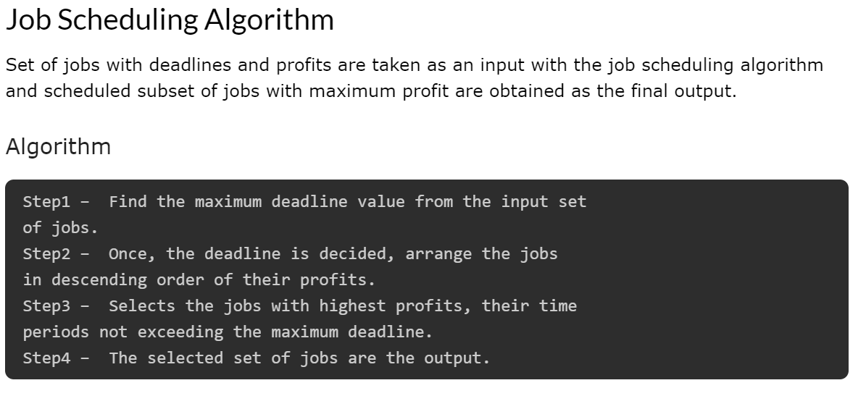

Slide 4
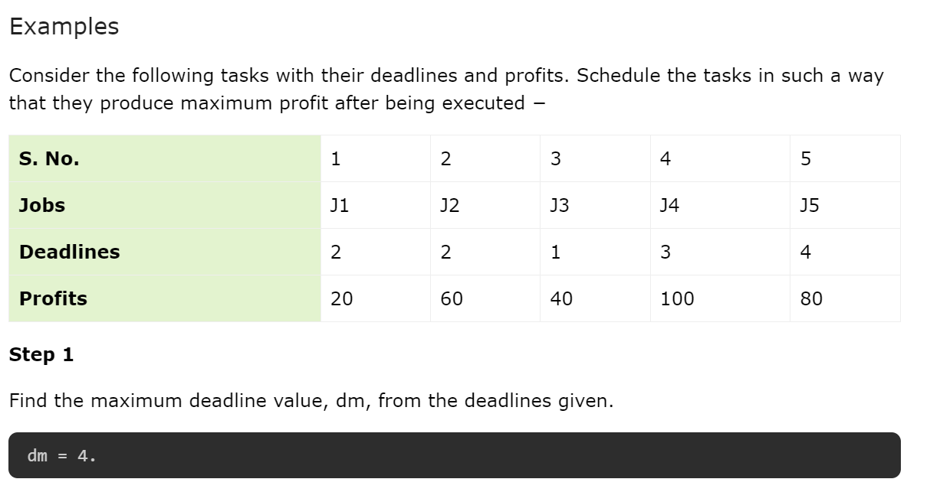

Slide 5
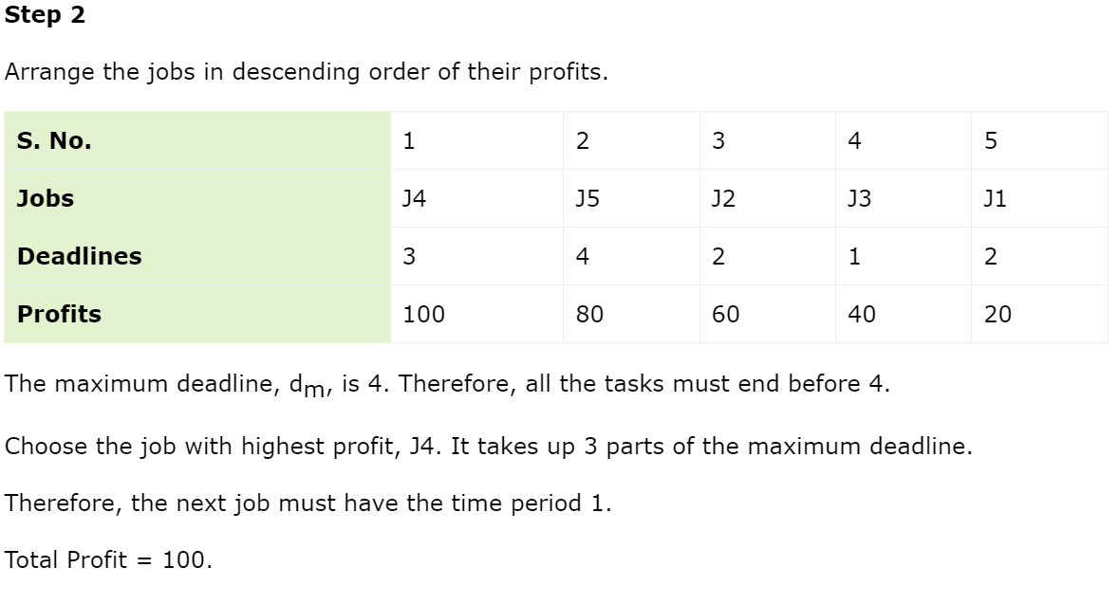

Slide 6
